Slide 1
My Scrum-Agile approach Proposal for SNHU Travel
Transition from Waterfall to Agile
Sprint Planning, Sprint Meeting, Sprint Review and Retrospective based on client’s feedback and team progression
Scrum Master coach the Development Team to follow 4 values and 12 principles of the Agile Manifesto
We focus into 4 roles: Product Owner, Scrum Master, Developer and Tester

Slide 2
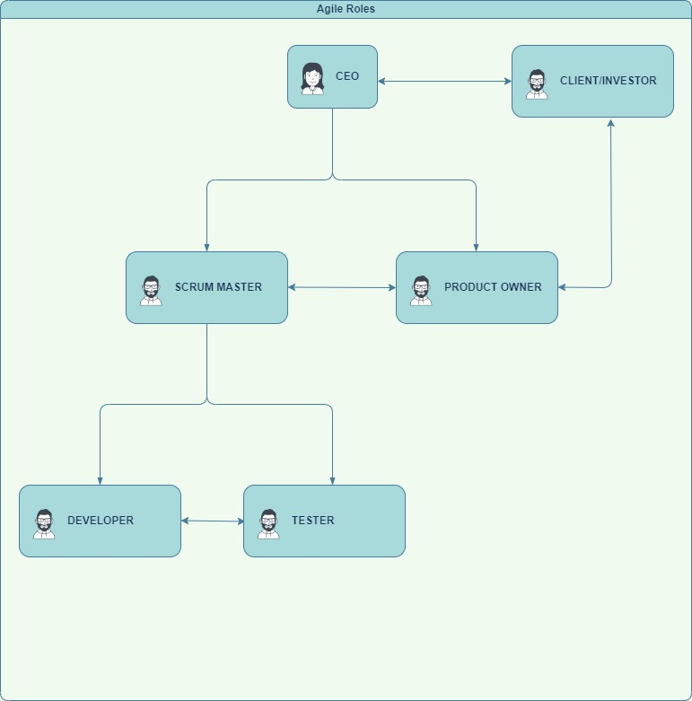
Scrum-Team Structure
Product Owner determine the project’s visionary
Scrum Master concentrate on facilitate the team’s growth
Development Team (Developer and Tester) focus on executing the work order and testing the product

Slide 3
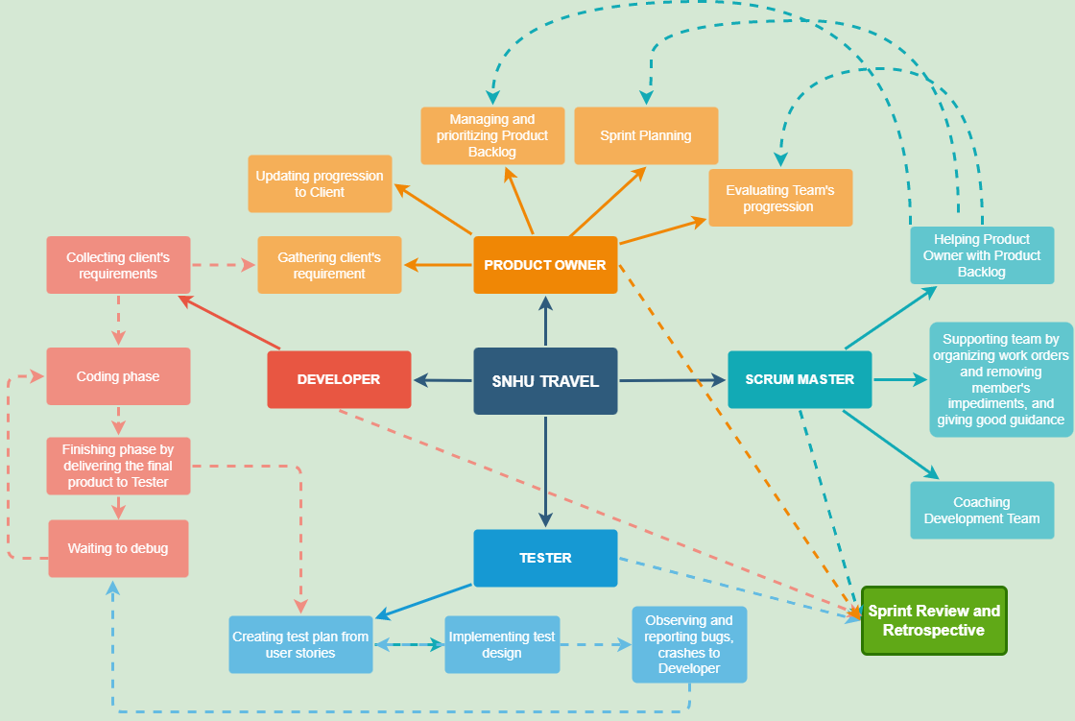
How Scrum-Team Work

Slide 4
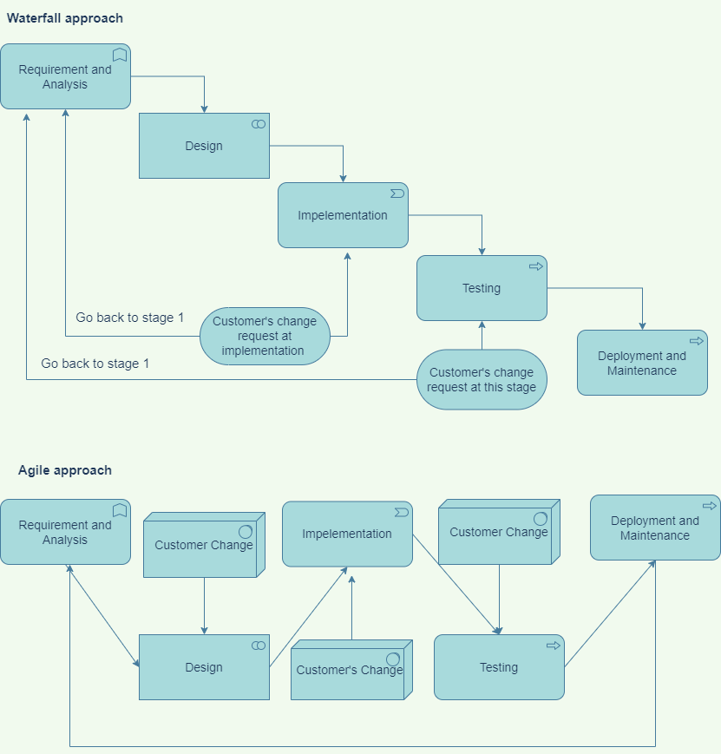
Waterfall approach:
Unable to adapt to customer change immediately since it’s a fixed process
Time compromise is inevitable
For example: Customer request to shift the focus of SNHU Travel to wellness/retreat vacation at the very last stage of testing.
Agile approach:
Work flow is not interrupted by customer’s change since it blends through to each stage
Encourage client’s feedback on every stage

Slide 5
References
Hoory, L., Bottorff, C., (2022, March 25).Agile vs. Waterfall: Which Project Management Methodology Is Best For You. Forbes
https://www.forbes.com/advisor/business/agile-vs-waterfall-methodology

